Slide 1

Beautiful and Functional Responsive Tables

Slide 2
Common approaches

Slide 3
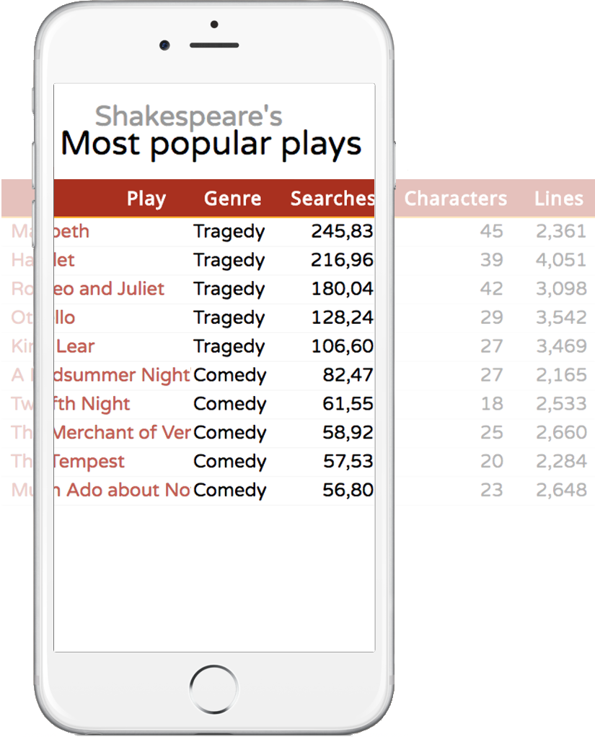
Common approaches
Scroll horizontally

Slide 4
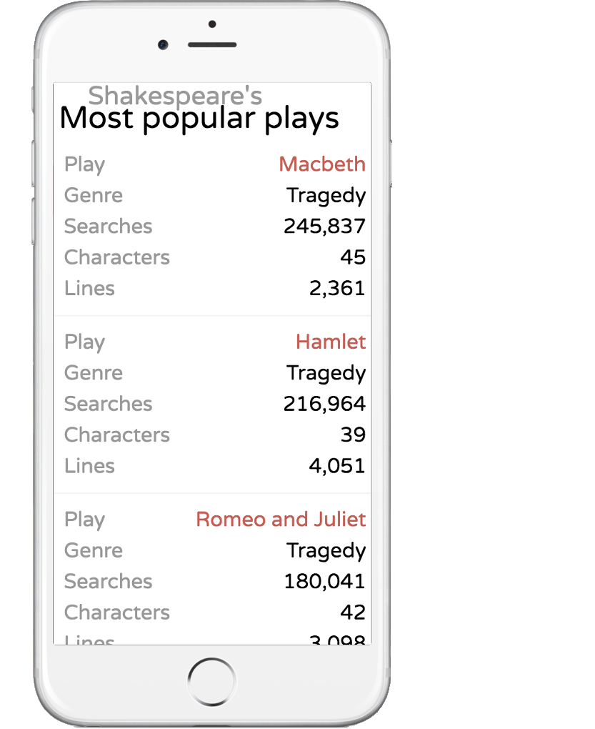
Common approaches
Scroll horizontally
Stack vertically

Slide 5
Alternative approach

Slide 6
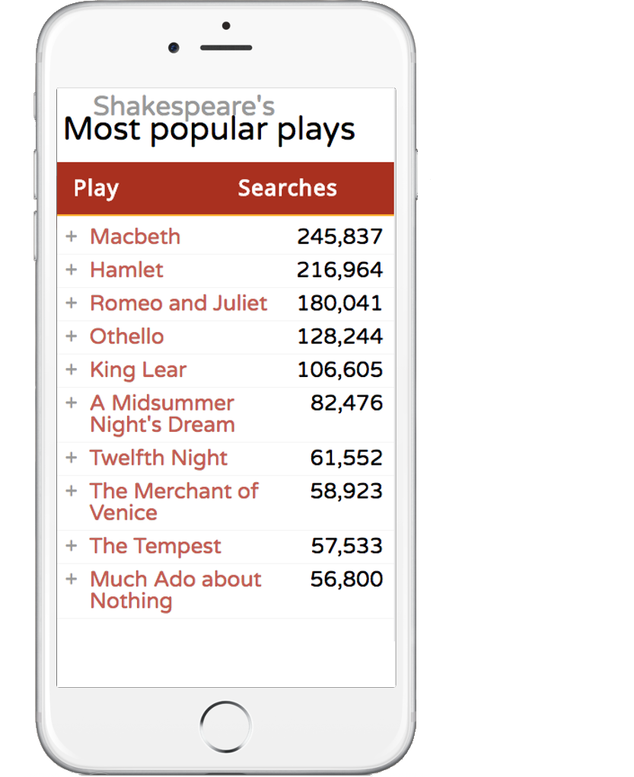
Alternative approach
Two column table

Slide 7
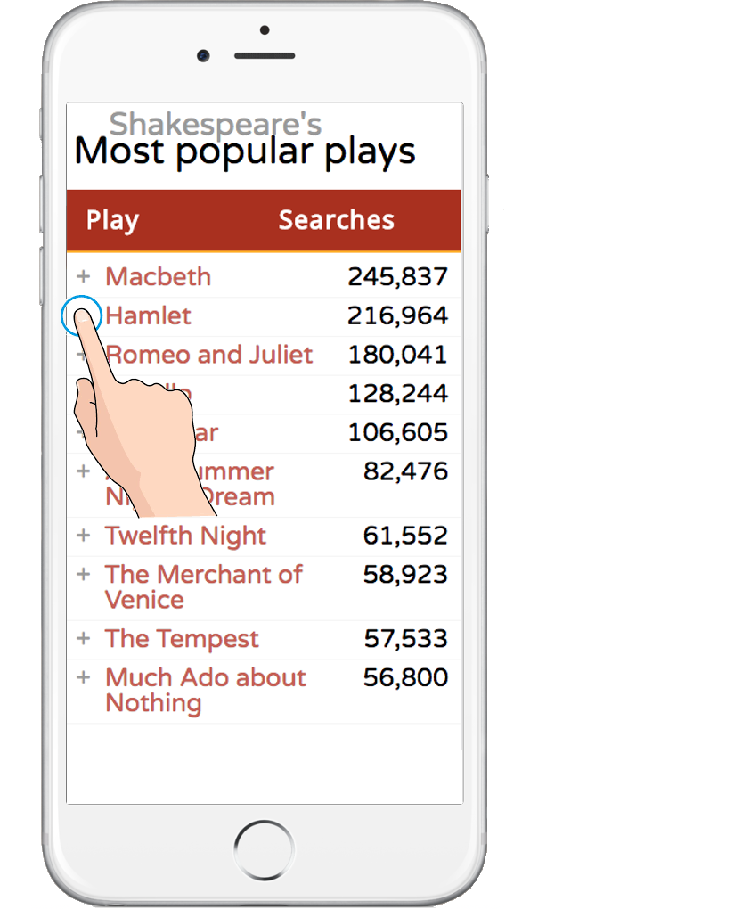
Alternative approach
Two column table
Click to expand vertically

Slide 8
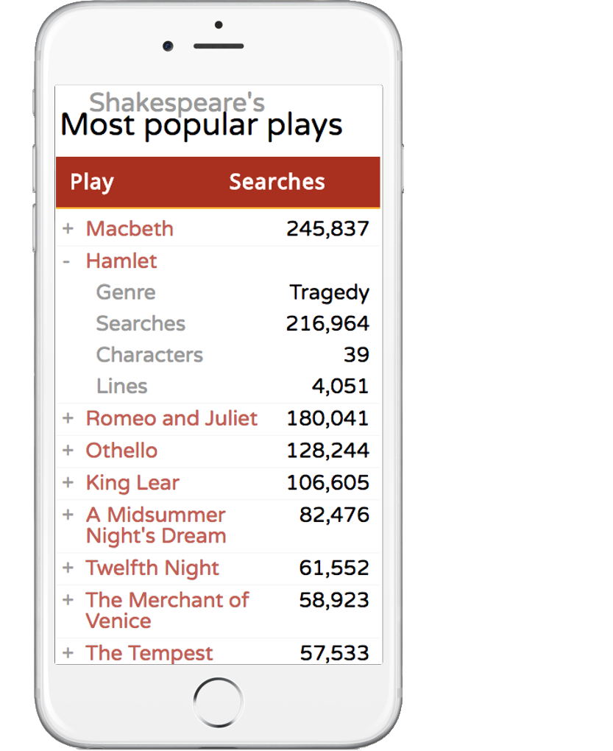
Alternative approach
Two column table
Click to expand vertically
Details shown stacked

Slide 9

Alternative approach
Two column table
Click to expand vertically
Details shown stacked
Click again collapse

Slide 10
Alternative approach
Two column table
Click to expand vertically
Details shown stacked
Click again collapse

Slide 11
Plain CSS

Slide 12
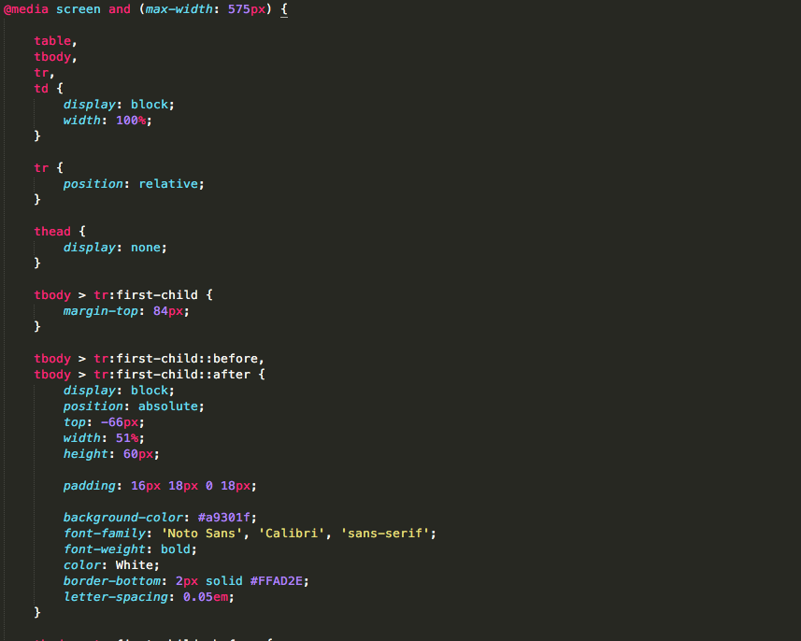
Plain CSS
CSS to manipulate cell display

Slide 13
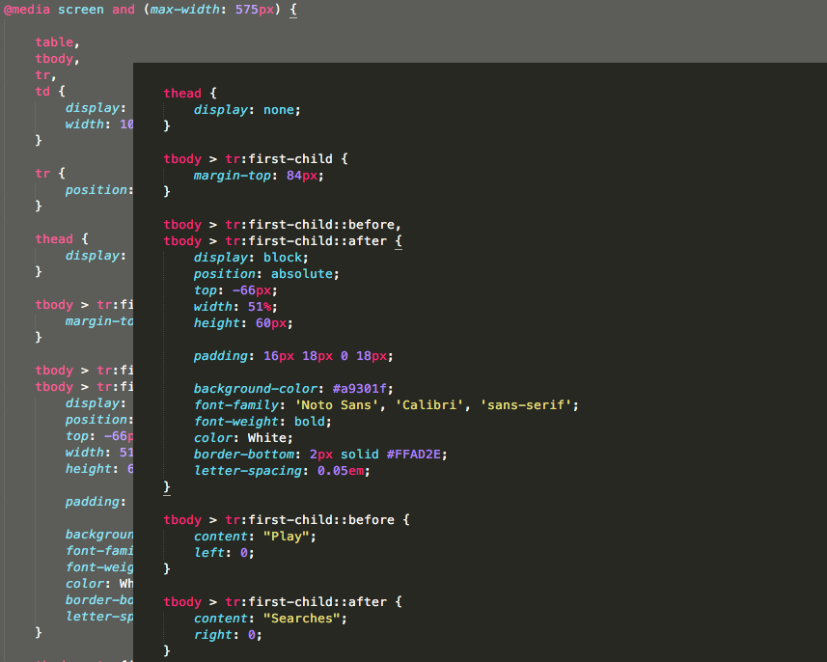
Plain CSS
CSS to manipulate cell display
Show new headers

Slide 14
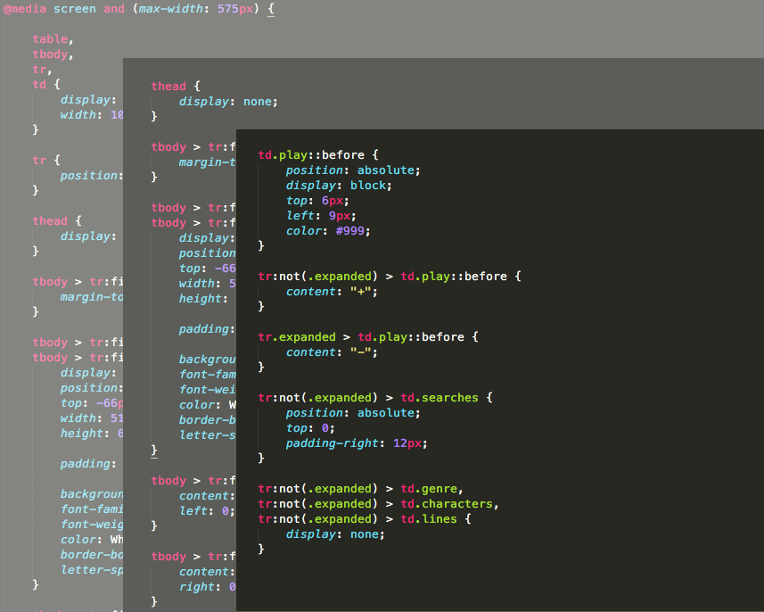
Plain CSS
CSS to manipulate cell display
Show new headers
Add Expand/Collapse Icons
Hide secondary columns

Slide 15
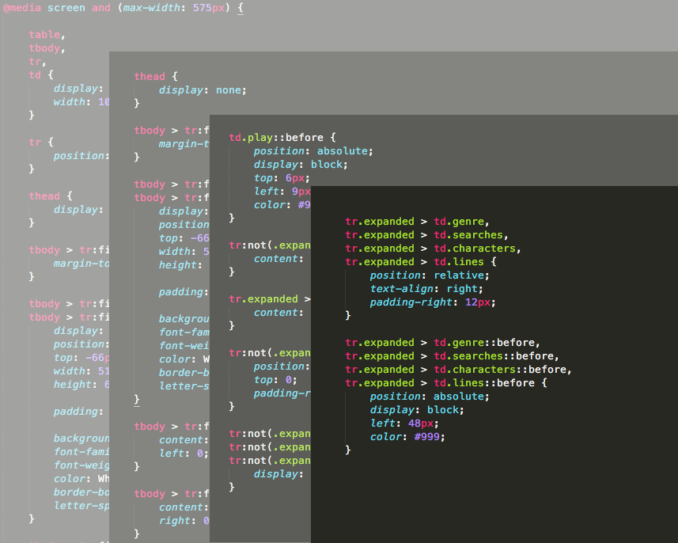
Plain CSS
CSS to manipulate cell display
Show new headers
Add Expand/Collapse Icons
Hide secondary columns
Show secondary columns

Slide 16
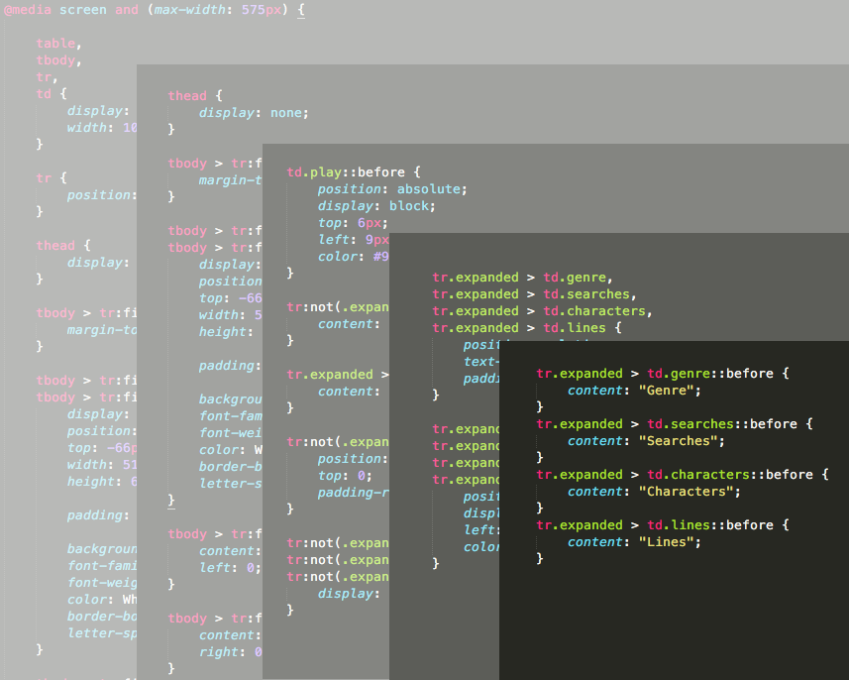
Plain CSS
CSS to manipulate cell display
Show new headers
Add Expand/Collapse Icons
Hide secondary columns
Show secondary columns
Add detail headers

Slide 17
Minimal JavaScript

Slide 18
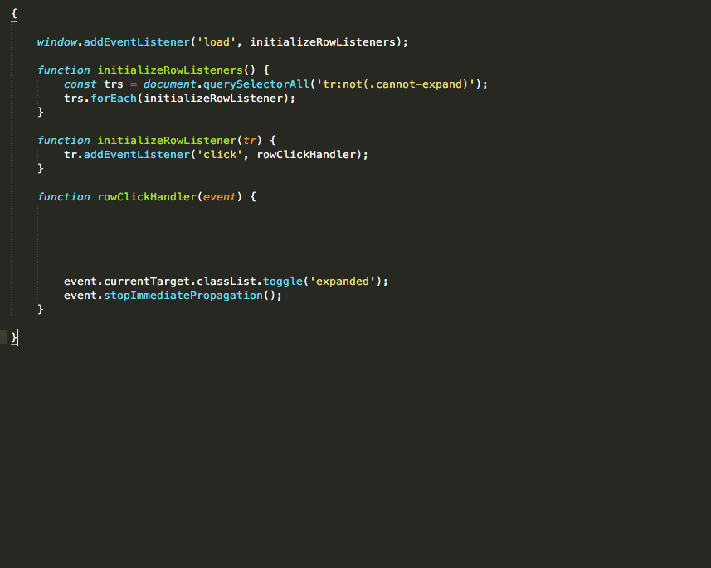
Minimal JavaScript
Row-click – expand/collapse

Slide 19
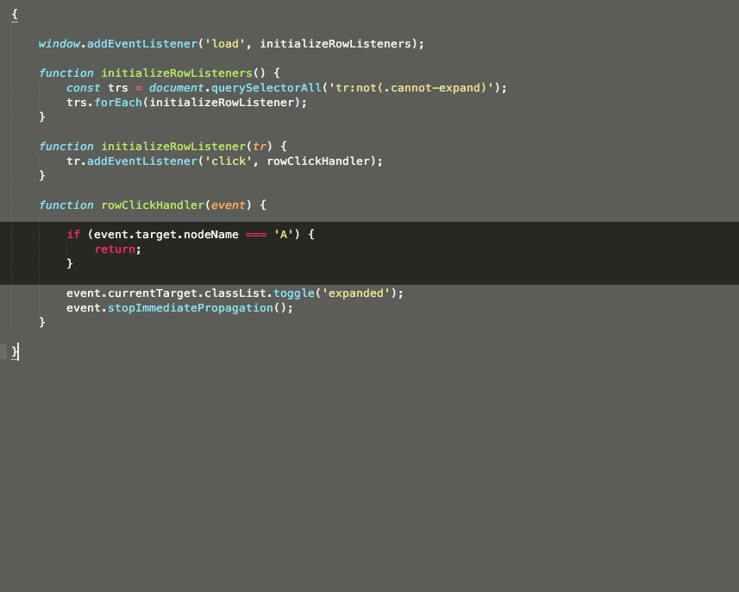
Minimal JavaScript
Row-click – expand/collapse
Beware links within content

Slide 20

Code

